Slide 1
Sulfur Oxidizing Bacteria Biosensor: Principles & Applications
By
Dr. Sedky .H.A. Hassan
Botany & Microbiology Dept.
Faculty of Science, New Valley University
Egypt
Email: sedkyhassan@aun.edu.eg

Slide 2
Introduction
Contamination
of
Environment
Rapid
Industrialization
Chemical assays
&
Biological
Methods
INRODUCTION

Slide 3
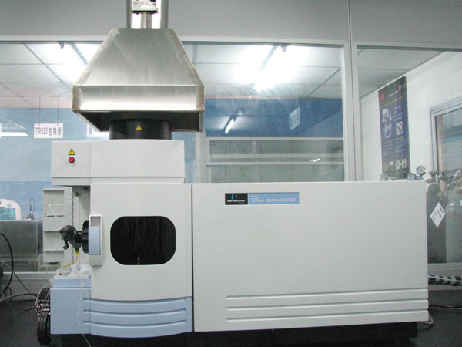
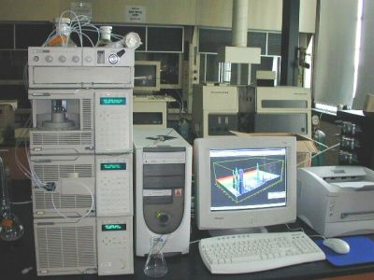
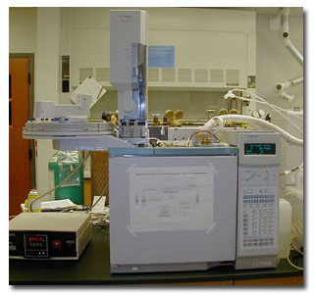
Chemical assay
INRODUCTION

Slide 4
Toxicity Bioassay
Eukaryotic
Bioassay Methods
Prokaryotic
INRODUCTION

Slide 5
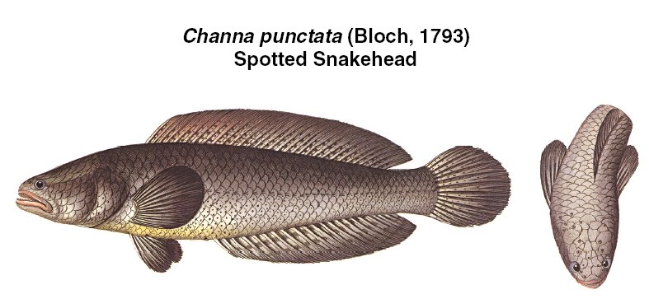
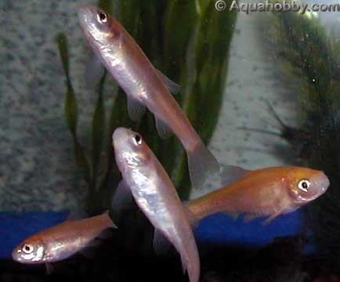
Fish
Mortality or movement direction
ATP
Survival
Some fish are not sensitive to low concentration,
Test take some days
Tolerate pollutants and they need specialized equipment and operators with adequate skills
INRODUCTION

Slide 6
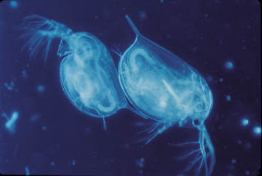
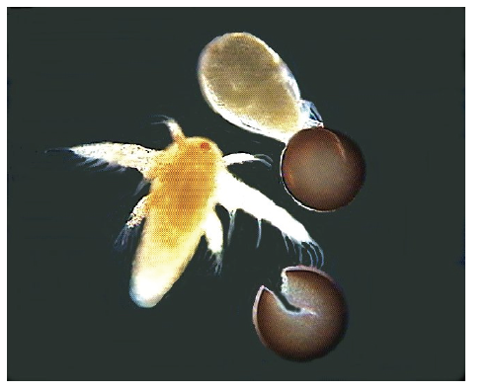
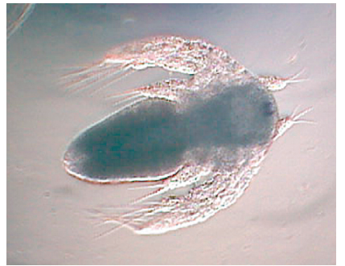
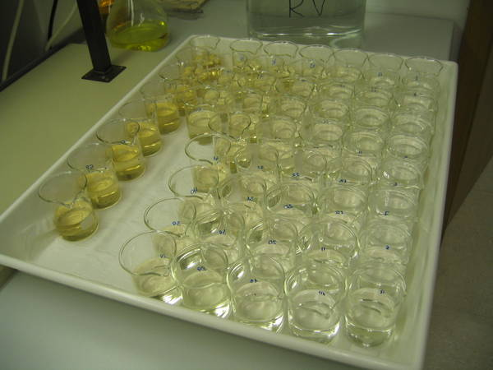
Daphnia & Shrimp
Mortality or motlity, cell count, speed variation
High sensitivity to toxicants, simplicity, short exposure duration, short reproductive cycle and parthenogenetic reproduction
Operator skills, less senstivity
INRODUCTION

Slide 7
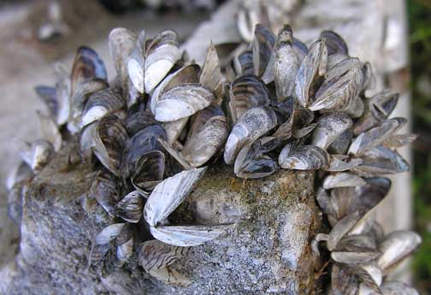
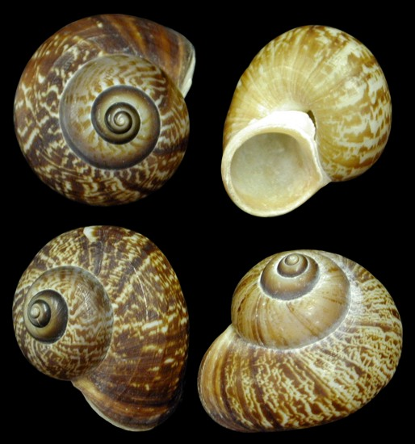
Snails
Mortality
Open and closed of shell
Egg production
Less sensitivity to low concentration
Operator skills
INRODUCTION

Slide 8
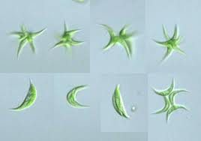
Algae bioassay
Mortality or photosynthesis activities
Algal growth
enzymatic activity
cell count
The growth of the algae exposed to the test substance is compared with the growth of the algae in an appropriate control over a fixed period of time under defined conditions.
INRODUCTION

Slide 9
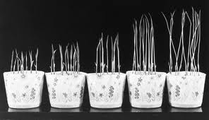
Plants bioassay
Chinese cabbage, oats
Vicia faba, Allium cepa
Micronucleus, genotoxic
germination rate, biomass weight,
enzyme activity
Require a long time for growth to occur, e.g., 4-6 days for length measurement of root and shoot of the plants, 14-30 days for fresh or dry weight measurement and 21 days for germination scores.
INRODUCTION

Slide 10
Microbial Bioassay Advantages
1
Quickly, easily detection protocol,
2
Less time consuming
3
Inexpensive
4
More sensitive
5
Short life cycle
INRODUCTION

Slide 11
Microbial Bioassay based Mechanism
1
Monitoring in the growth rate
2
Biochemical properties, mortality
3
Capacity of microorganisms to transform carbon, sulfur or nitrogen
4
Bioluminescence
5
Photosynthetic activity
INRODUCTION

Slide 12
Microbial Bioassay based Mechanism
7
Nitrification inhibition
8
Enzyme activity and inhibition
9
Fluorescence of chlorophyll
10
Respiration, oxygen consumption
INRODUCTION

Slide 13
Microorganisms
Aerobic bacteria
Bioluminescent bacteria
Algae
Nitrifying bacteria
Bacteria in microbial fuel cells
Activated Sludge
Genetic engineered bacteria
Photobacterium phosphoreum
Vibrio fischeri
Iron oxidizing bacteria
Oligotrophic bacteria
Yeast
INRODUCTION

Slide 14


Bioluminescence, bacterial growth
INRODUCTION

Slide 15
Some disadvantages
1
Need special instrument such as spectrophotometer, respirometer, photometer, microtox….etc.
2
Work at neutral or high pH
3
Contamination
4
Need training person

Slide 16
Biosensors?
Biosensors are analytical devices, constructed by combining a biological sensing element (e.g., enzymes, antibodies, microorganisms or DNA) with a transducer (e.g., electrochemical, optical, thermal) to obtain signal output.
INRODUCTION

Slide 17
An ideal biosensor should be:
Reliable and reproducible;
Economical of time and resources;
Relevant, practicable and readily understood by the layman;
Validated
Simple to use and specifiec.
Useful for large monitoring analysis
With a clearly defined end-point;
Sensitive to a wide range of pollutants.
Response to low concentration of pollutants.
INRODUCTION

Slide 18
Microbial Biosensor
Analyte
Transducer
Signal
S
P
A whole-cell biosensor contains living organisms, such as bacteria, microalgae, yeast or fungi as the sensing elements through transducer (release ions, H+, light emission). The transducer convert biological signal into measurable response such as current or voltage or conductivity.
INRODUCTION

Slide 19
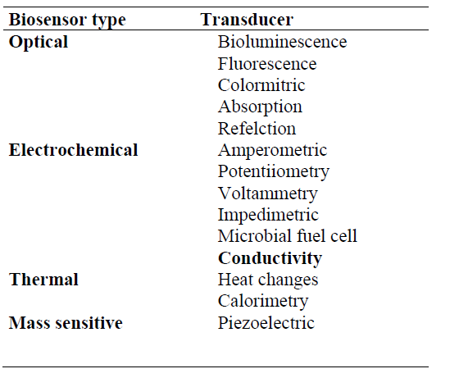
Microbial Biosensor
INRODUCTION

Slide 20
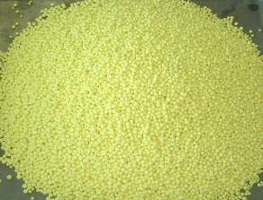
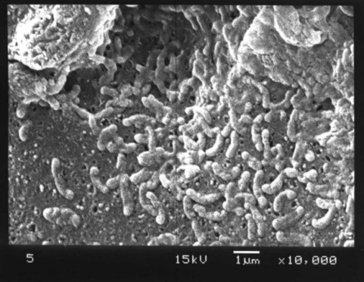
Sulfur Oxidizing Bacteria
Sº + H₂O + 1.5 O₂ → SO₄²⁻ + 2H⁺
Oxidation of S results in the formation of sulfuric acid (SO₄²⁻ and H⁺) which lowers the medium pH.
The production of sulfate ions increases the electrical conductivity (EC) of the medium
In presence of toxic chemicals
The activity of SOB will be inhibited, which will cause an increase in pH and a decrease in EC.
OBJECTIVE

Slide 21
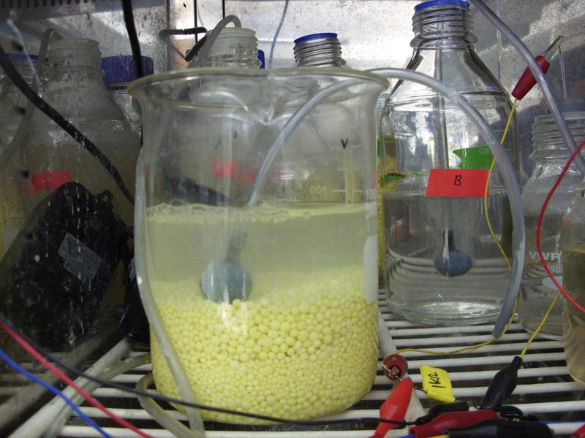
MCR
Operating conditions
NMB media (100 X)
Inoculum: SWW
Sulfur particles (2-4 mm)
Air flow rate (150-200ml/minutes)
Temperature 30 °C
MATERIALS & METHODS

Slide 22
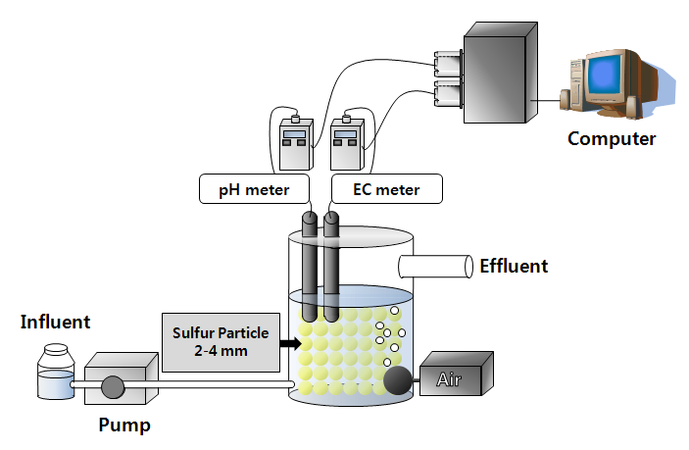
A schematic diagram of Sulfur Oxidizing Bacteria Biosensor
MATERIALS & METHODS

Slide 23
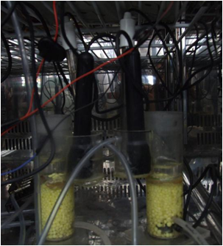

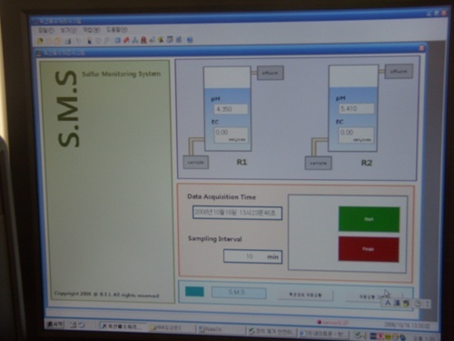
Continuous Monitoring system
pH probe
EC probe
Computer
Effluent port
Sulfur particles
(2
-
4mm)
Influent
Air
Pump
Sulfur particles: 2-4 mm
Volume: 50 ml of sulfur
Medium: NMB medium diluted to 100 times
Influent EC 0.14 mS/cm, pH 6.9
HRT: 30 mints
Time intervals: 10 mints
Temp: 30 ºC
MATERIALS & METHODS

Slide 24
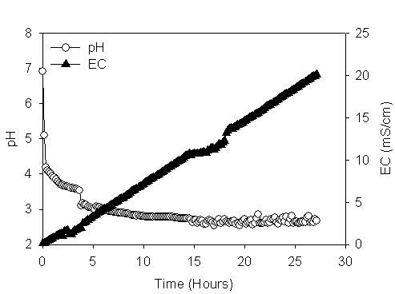
Batch mode
Operating conditions
Sulfur particles: 2-4 mm
Volume: 50 ml of sulfur
Medium: NMB diulted 100 times
Initial EC 0.12 mS/cm,
pH 6.9
Time intervals: 10 mints
Temp: 30 ºC
Operation: Batch mode
RESULTS

Slide 25
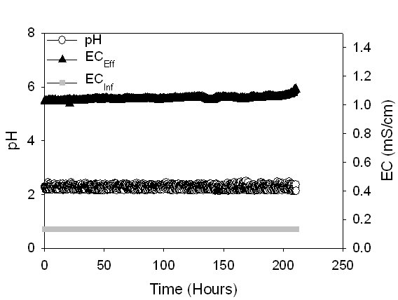
Steady state
Operating conditions
Sulfur particles: 2-4 mm
Volume: 50 ml of sulfur
Medium: Stream water
Influent EC 0.14 mS/cm,
pH 6.9
HRT: 30 mints
Time intervals: 10 mints
Temp: 30 ºC
RESULTS

Slide 26
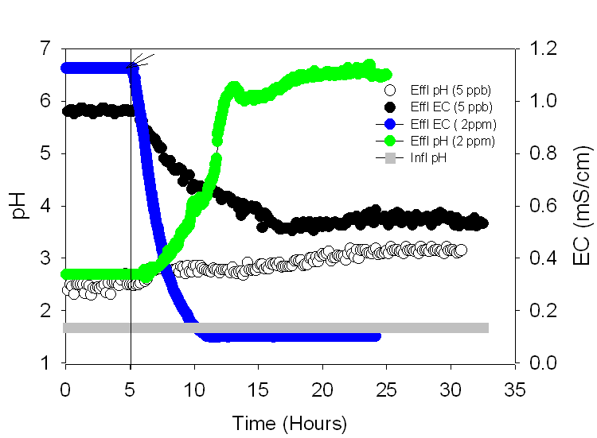
Detection of Cr⁶⁺ by SOB biosensor.
RESULTS

Slide 27
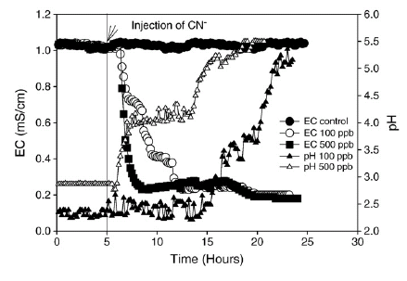
Toxicity of CN⁻
Operating conditions
Sulfur particles: 2-4 mm
Volume: 50 ml of sulfur
Medium: NMB diulted 100 times
Initial EC 0.12 mS/cm,
pH 6.9
Time intervals: 10 mints
Temp: 30 ºC
Operation: Batch mode
RESULTS

Slide 28
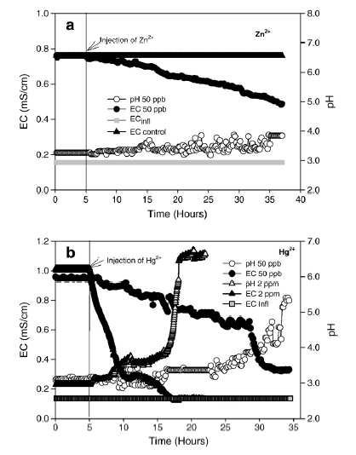
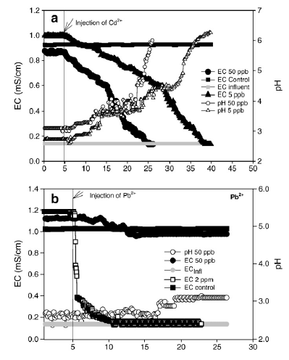
Toxicity of heavy metals
RESULTS

Slide 29
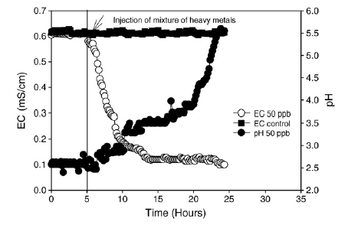
Mixture of heavy metals
Operating conditions
HRT: 30 min
Sulfur particles 2-4, mm)
Mixture of heavy metals (Cd²⁺, Pb ²⁺, Hg ²⁺ was added after 5 hours.
Conc: 50 ppb
RESULTS

Slide 30
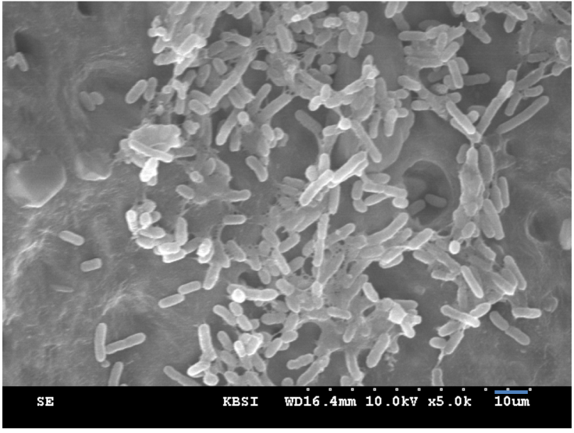
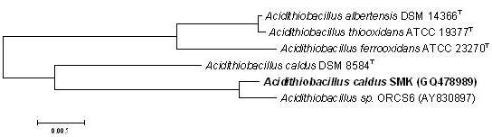
SOB bacteria
99.8 % of bacterial count was autotrophic SOB
0.2 % of bacterial count was heterotrophic bacteria
RESULTS

Slide 31
SOB bacteria
Character | Results | Character | Results | Character | Results
Morphology | flat, small, white | Arabinose | - | Orinithine | -
Gram stain | - | Sorbitol | - | Tryptophan | -
Indole | - | Inositol | - | Lactose | -
H2S | - | Orinithine | - | D-fructose | -
Urease | - | Saccarose | - | L-lysine | -
VP | - | D-Glucose | - | Citrate | -
Mannose | - | D-xylose | - | Autotrophs | +
Gelatin | - | D-galactose | - | Mixotrophic | +
Amyadalin | - | D-mannose | - | Heterotrophic | -
RESULTS

Slide 32
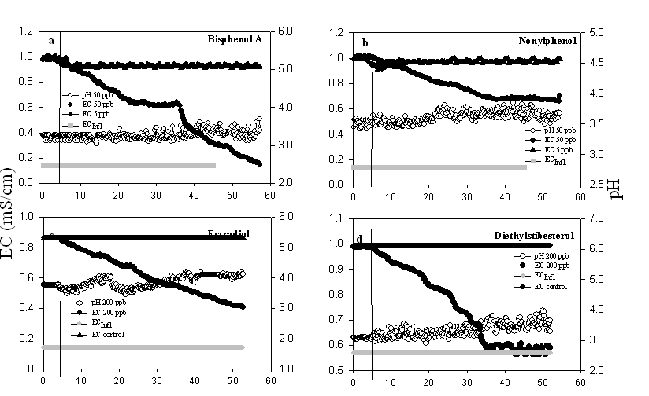
Endocrine disruptors (EDCs)
RESULTS

Slide 33
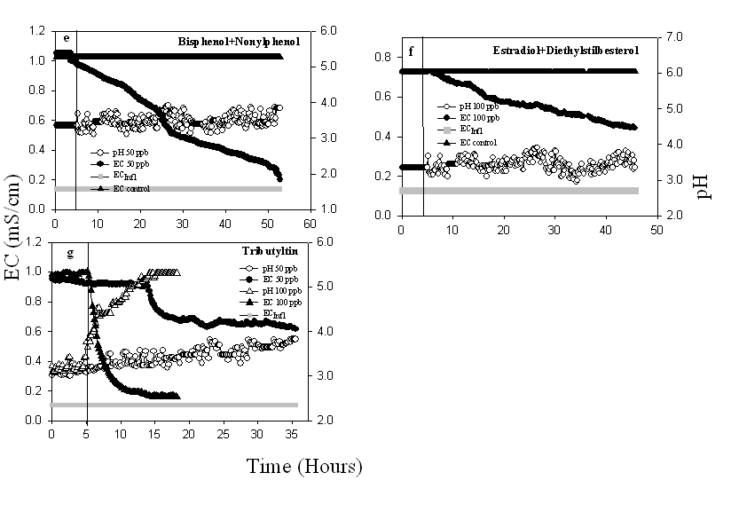
Endocrine disruptors (EDCs)
RESULTS

Slide 34
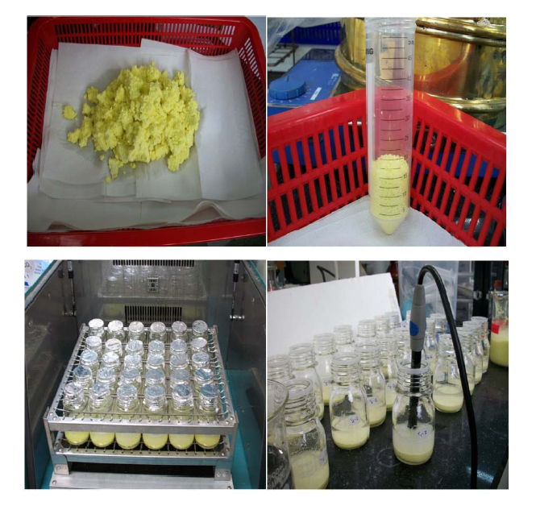
Detection of NO₂⁻N (Batch Mode)
SMCR
RESULTS

Slide 35
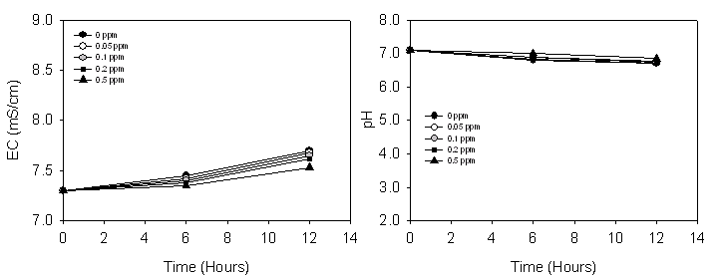
Detection of NO₂⁻N (Batch Mode)
To study the effect of pH, free nitrous acid (HNO₂), and alkalinity on SOB Alk (1567 mg/L)
RESULTS

Slide 36
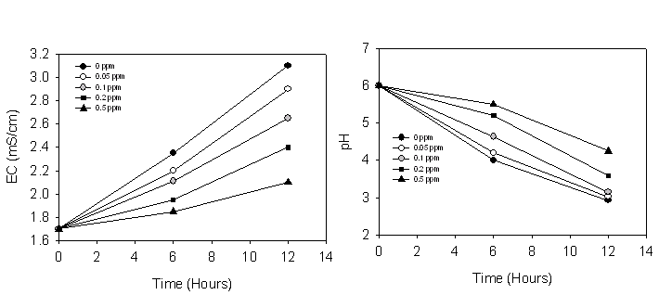
Detection of NO₂⁻N (Batch Mode)
To study the effect of pH, free nitrous acid (HNO₂), and alkalinity on SOB Alk (293 mg/L)
RESULTS

Slide 37
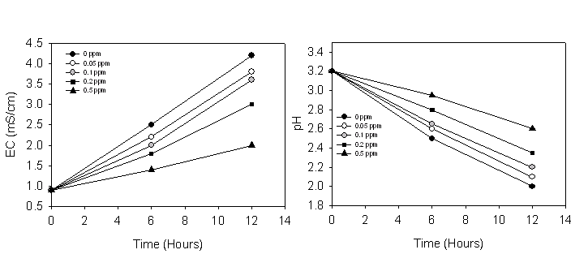
Detection of NO₂⁻N (Batch Mode)
pKa (3.1)
Free radicles
HNO₂
To study the effect of pH, free nitrous acid (HNO₂), and alkalinity on SOB Alk (17.5 mg/L)
RESULTS

Slide 38
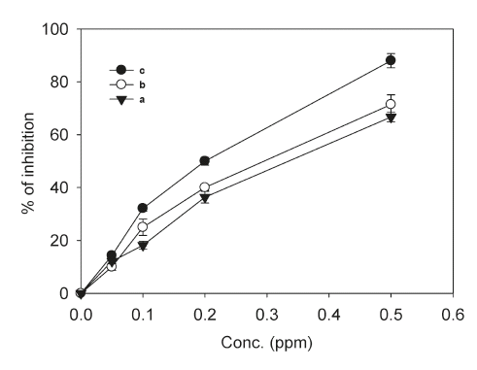
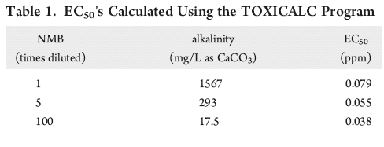
Inhibition %
RESULTS

Slide 39
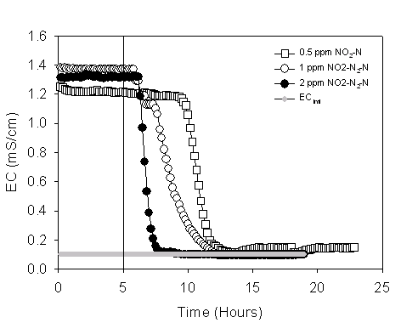
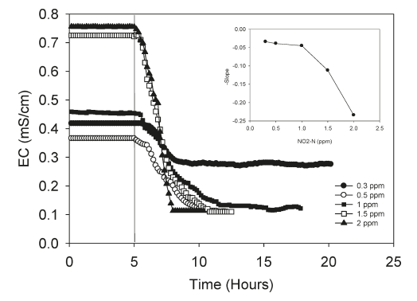
Detection of NO₂-N
RESULTS

Slide 40
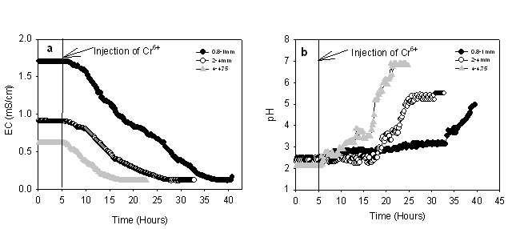
Effect of S° particle size
Operating conditions
HRT: 30 min
Sulfur particles
(0.8-1.0, 2-4, 4.0-4.75 mm)
Cr⁶⁺ (50 ppb) was added
after 5 hours
RESULTS

Slide 41
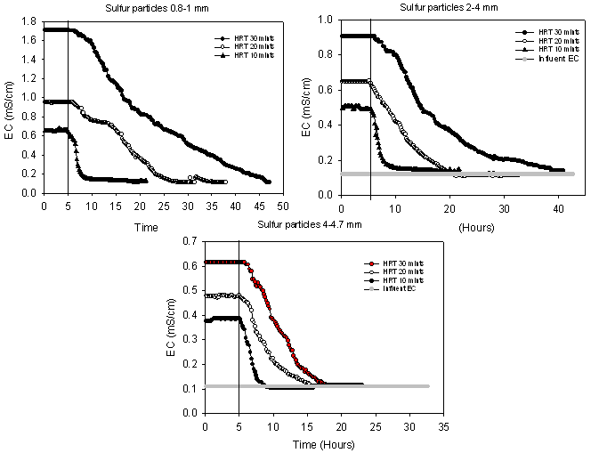
Effect of HRT
Operating conditions
HRT: (30, 20, and 10 min).
Cr⁶⁺ (50 ppb) was added
after 5 hours of operation.
RESULTS

Slide 42
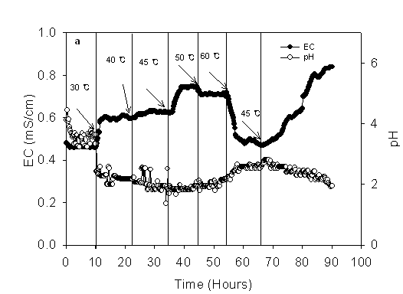
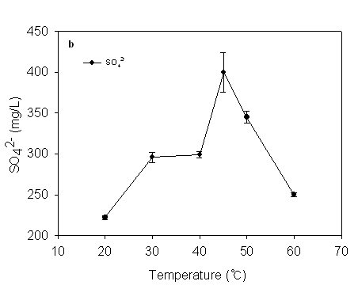
Effect of temperature
Operating conditions
HRT: 30 min
Sulfur particles
(2-4, mm)
Different temperatures ( 20, 30, 45, 50, 60 °C)
RESULTS

Slide 43
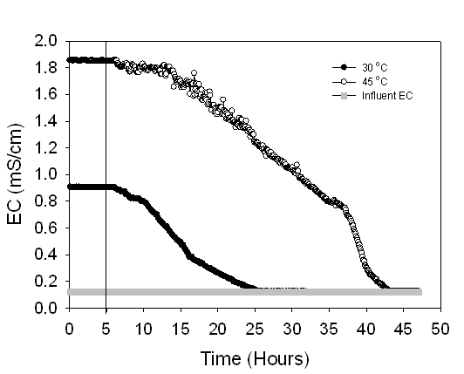
Effect of temperature on Cr⁶⁺ detection
Operating conditions
HRT: 30 min
Sulfur particles(2-4, mm)
Temp (30, 45 °C)
Cr⁶⁺ (50 ppb)
RESULTS

Slide 44
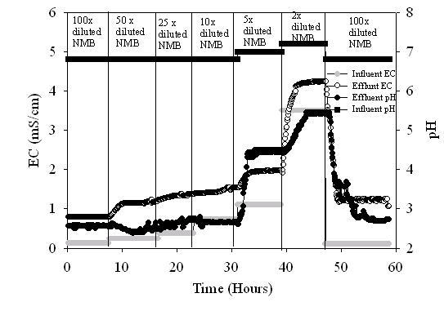
Effect of alkalinities
Operating conditions
HRT: 30 min
Sulfur particles(2-4, mm)
Different alkalinities
RESULTS

Slide 45
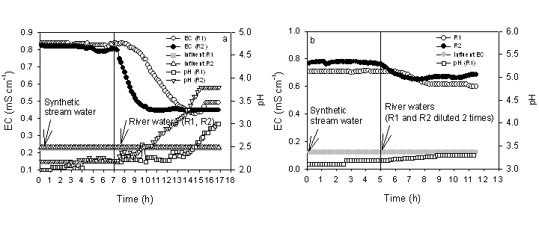
Detection of stream water by SOB biosensor.

Slide 46
Assessment of industrial effluent by SOB biosensor.

Slide 47
Physicochemical parameters of textile industry effluent and river waters
 | UNIT | C1 | R1 | R2
pH | - | 8.5 | 7.6 | 7.26
EC | mS/cm | 1.25 | 0.2 | 0.23
Ammonia | ppm | 6.7 | 2 | 2.2
NO₂-N | ppm | 1.1 | 0.18 | 0.48
NO₃-N | ppm | 9.43 | 3.4 | 3.47
PO₄- | ppm | 1.58 | 0 | 2.45
1,4 Dioxane | ppm | 0.27 | - | -
Cd | ppm | 0.001 | 0.001 | 0.001
Cr | ppm | ND | ND | 0.001
Cu | ppm | ND | 0.002 | 0.003
Pb | ppm | 0.019 | 0.012 | 0.02
Hg | ppm | 0.002 | ND | ND
Zn | ppm | 0.014 | 0.01 | 0.025

Slide 48
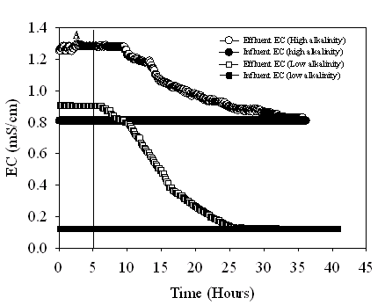
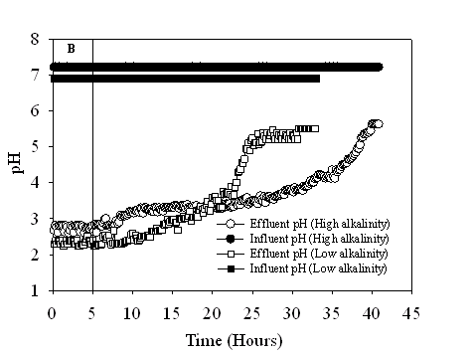
Effect of alkalinities
Operating conditions
HRT: 30 min
Sulfur particles(2-4, mm)
Different alkalinities
Cr⁶⁺ (50 ppb)
RESULTS

Slide 49
Conclusions
The methods is consider a new assay for toxicity assessment.
SOB biosensor detect toxic chemicals in different mode.
SOB biosensor can be improved by changing HRT or increasing sulfur particles size.
Detection of many toxic chemicals.
CONCLUSIONS

Slide 50
Conclusions
SOB biosensor detect toxic chemicals in industrial effluents.
Recovery after toxicity.
Can be operated at different temperature
The sensitivity to detect toxic chemicals increase at low alkalinity.
CONCLUSIONS

Slide 51
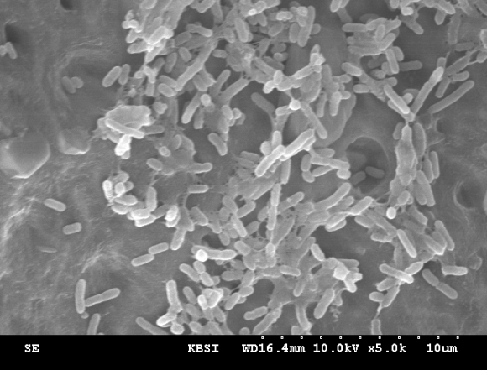
Advantages of SOB
Simplicity
Sulfur is cheap
High sensitivity
Easy operation
Different mode
No Contamination
No specific media
No calibration needed
Operation for long time
Ability to monitor toxicity in real-time
Minimize the formation of complexes (low pH)
Eco-friendly
CONCLUSIONS

Slide 52
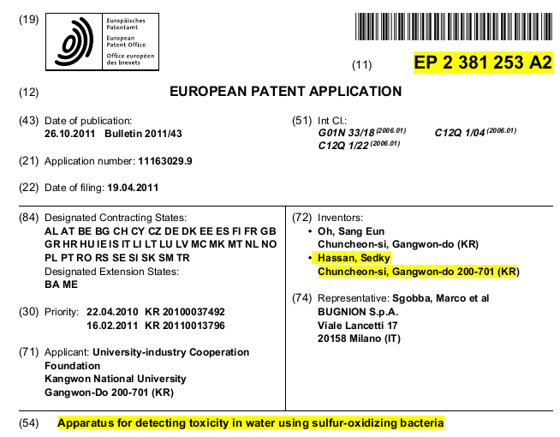
PATENTS

Slide 54

شكرا لحسن الاستماع

