Slide 1
Microbial Electrolysis Cell
How to set up a full biological MEC
Tahereh Jafary

Slide 2
  Problem statement
Climate change, Fossil fuel depletion, population growth
High demand for alternative energy sources
Increasing need for renewable and clean sources of energy
Values inside waste trigger waste to wealth strategies
Energy Production to balance high energy intensive waste treatment processes
safe and efficient process with mild operational conditions to hinder high energy consumption
lowering chemical and pollutant input which may need further complicated process to remove and will interfere with biological life because the waste streams release to environment after matching basic releasing requirements but long and continuous releasing(a clear examples are landfills and other final waste disposal locations while process for that chemicals have their own energy and labour demand and waste production

Slide 3
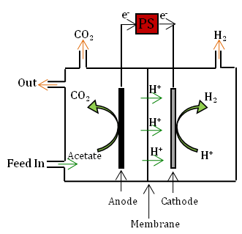
Microbial electrolysis cells (MECs):
a promising technology for the production of hydrogen from a wide range of organic matters, with aid of electrochemically active bacteria combined with addition of a small voltage
Final product forms in the cathodic chamber
The reduction rate of electrons on the cathode among the rate limiting steps in a MEC(Cathodic Overpotential)
Cathode and its catalyst contribute to about 50% of the cost of a MFC
C₂H₃O₂⁻ + 2H₂O → 2CO₂ + 8e⁻ + 7H⁺, E˚ _{acetate / CO2}=-0.289V vs. NHE at pH=7, (Eq.1)
O₂ + 4H⁺ + 4e⁻ →2H₂O, E˚_{H+/H2O}=+0.818V vs. NHE at pH=7 , (Eq.2)
2H+ + 2e-→ H2, EH+/H2=-0.412V vs. NHE at pH=7 (Eq.3)
To reduce the over potential a catalyst is used on the cathodes
known Mechanism
Known Enrichment procedure
Limiting effect on biocathode performance
MECs & MFCs:
E vs. NHE (mV)
e⁻
V
e⁻
CO₂
O₂
Precious Metal catalyst
+818
O₂/H₂O
MFC: electricity generation
MEC: H2 production
They are expensive,
Their mining and extraction process imposes negative impact on the environment.
They could be deactivated by some constituent, e.g. sulfur, which is a common content in wastewater
Out
CO₂
H⁺
H₂O
H₂O
H⁺
Feed In
Acetate
H⁺
O₂
O₂
Spontaneous Voltage generating reaction in MFC
Anode
Cathode
0
0
Membrane
Biocathode
e⁻
PS
e⁻
CO₂
H₂
Inexpensive
Environmentally friendly,
holds a self-generative character
resistant to certain levels of impurities such as sulphur
Unknown Mechanism
Enrichment, startup and maintenance challenges
Low product rate
Product contamination
Out
-289
Acetate/CO₂
Nonspontaneous power -source needed reaction in MEC
CO₂
H⁺
H₂
H⁺
- 414
H⁺/H₂
?
Feed In
Acetate
H⁺
H⁺
Anode
Cathode
Membrane
Anode
Cathode

Slide 4
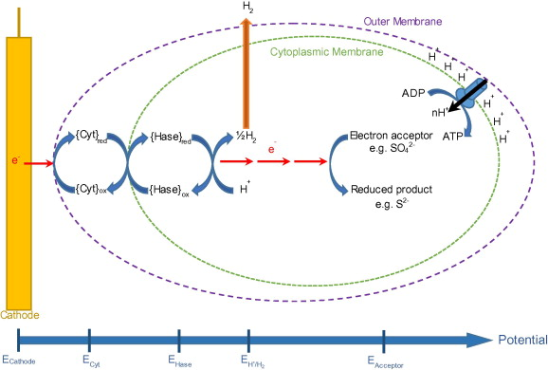
The BES anode operational mode has been shown to have a significant impact on the overall performance of the system, while the upscaling of the BES system needs a systematic conception of the operational conditions (Pasupuleti et al., 2015).
  Biocathode MEC Configuration and startup process
MFC-MEC biocathode system
SRB has been discovered as the main microbes in MEC biocathode. Desulfovribio sp. has been reported as the dominant species in several MEC biocathode characterization studies (Aulenta et al., 2012; Croese et al., 2011; Pisciotta et al., 2012). Kim et al. (2015) suggested that a hydrogen cycling mechanism is used by Desulfovribio sp. to reduce H+ by taking electrons from the cathode. It was proposed that the hydrogenase existing either in the cytoplasm or on the cytoplasmic membrane reduces H+ through an enzymatic reaction. Consumption of H+ in the cytoplasm and diffusion of the H2 through the cytoplasmic membrane forms a proton driving motive. Subsequently, the hydrogen diffuses to the periplasm. The hydrogenase located in periplasm will oxidize the hydrogen. Electrons are transported back to the cytoplasm to reduce sulfate consuming protons and develop a proton gradient (Kim et al., 2015). There is no report for an ability of Desulfovribio spp. to grow autotrophically, however Acetobacterium was reported as the acetate supplier for Desulfovribio during enrichment stage over H2, CO2 and sulfate (LaBelle et al., 2014; van Houten et al., 1995).
MFC-O biocathode system
  Full biological two-chambered biocathode MEC
  2. Half biological two-chambered biocathode MEC
  3. Full biological single-chambered biocathode MEC

Slide 5
Objectives & Scopes
To enrich the biocathode in two-half biological MFC-MEC and MEC origin (MEC-O) configuration setups through an in-situ enrichment stage;
To characterise and analyse the bacterial community of the developed MEC biocathode.
To establish a full biological two-chamber MEC setup and to evaluate the performance;
To assess the anode mode of operation in a conventional two-chamber MFC and to evaluate the performance of the application further in running a full biological MEC setup;
To evaluate the effective parameters to enhance the hydrogen production rate over a long-term operation in the efficient MEC biocathode configuration and to measure the performance and efficiency of the MEC biocathode from an electrochemical perspective;
To enrich sulphate reducing bacteria from a mixed culture source of palm oil mill effluent (POME) through an ex-situ enrichment stage;
A full biological MEC (FB-MEC) has been established and studied. A bioanode and a biocathode were initially enriched and developed in two different systems where the counter reactions were performed abiotically. The abiotic condition for the counter compartment was selected to enable a non-limiting biofilm formation in the biological compartments. Therefore, the bioanode was enriched in a half biological MFC (HB-MFC) with a Pt-coated cathode (concerning the first abovementioned scope). The biocathode was enriched by using an SRB-rich culture in a half biological MEC (HB-MEC) with hexacyanoferrate (II) as the chemical electron donor in the anodic chamber (concerning the fourth abovementioned scope). Scanning electron microscopy (SEM) was employed to study the morphology and density of the biofilm attached to the electrodes. The enriched biocathode and bioanode were then transferred to the setup of the FB-MEC and studied under batch and recirculation batch modes of operation. The hydrogen production rate and electrochemical characteristics were analysed, and the results compared with the FB-MECs studied in the literature.
The biocathode in-situ enrichment process was studied concerning the effective parameters, e.g. the sulphate content of the cathodic medium and pH, by using the more efficient configuration (of the previous stage), to enhance the performance of the biocathode MEC. Consequently, linear sweep voltammetry (LSV) and electrochemical impedance spectroscopy (EIS) tests were carried out to study the onset potential of the HER and the cathodic charge transfer resistance in the developed biocathode systems, respectively.
The anode mode of operation was studied in a conventional MFC system to evaluate a simple and efficient operational mode for further establishment of a full biological MEC and to contribute to making the BES applicable in industrial and municipal facilities. Conventional batch and continuous modes of operation were compared with the recirculation batch mode of operation. Respective analyses were applied to assess the efficient operational mode.
Characterisation and analysis of the bacterial community of biofilm attached to the cathode. The biofilm samples were taken from the cathodes of the FB-MEC at various stages of enrichment. DNAs were extracted, and the bacterial communities on the electrodes were analysed applying the metagenomic amplicon sequencing method.
In-situ SRB-based biocathode MEC enrichment. The in-situ stage was performed by transferring the ex-situ enriched culture to the MECs. Two known, half biological configurations of MFC-MEC and MEC-O biocathodes were established, monitored and compared based on their hydrogen production rate at this stage.
SRB enrichment from a mixed culture source. The SRB were initially enriched over H2, CO2 and sulphate from a POME mixed culture source through an ex-situ enrichment stage. The sulphate content was monitored continuously over the ex-situ enrichment stage.

Slide 6
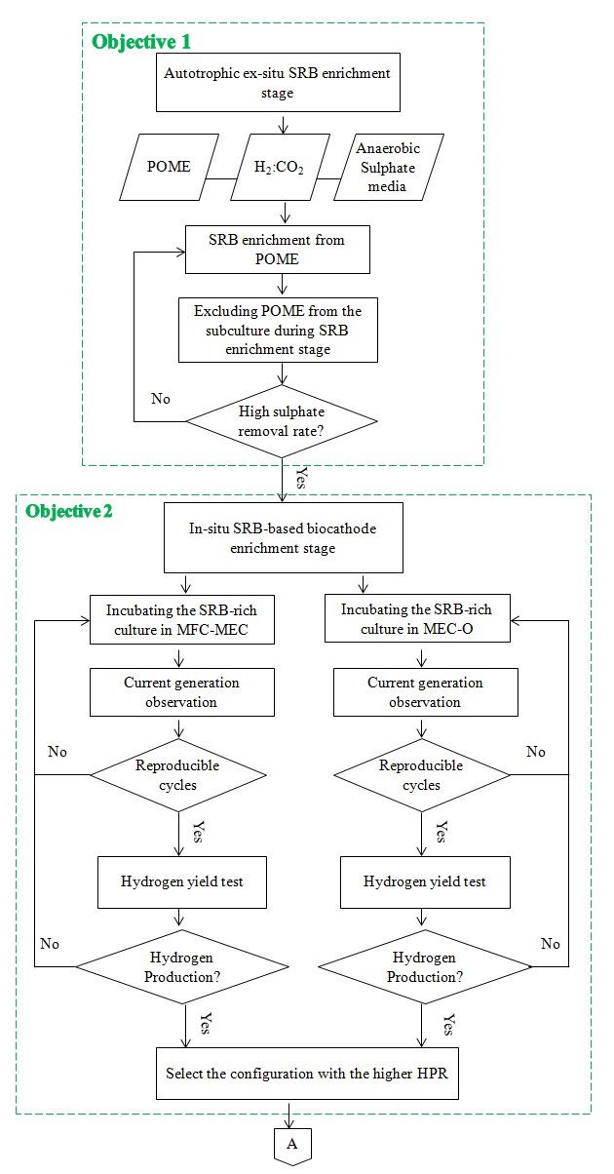
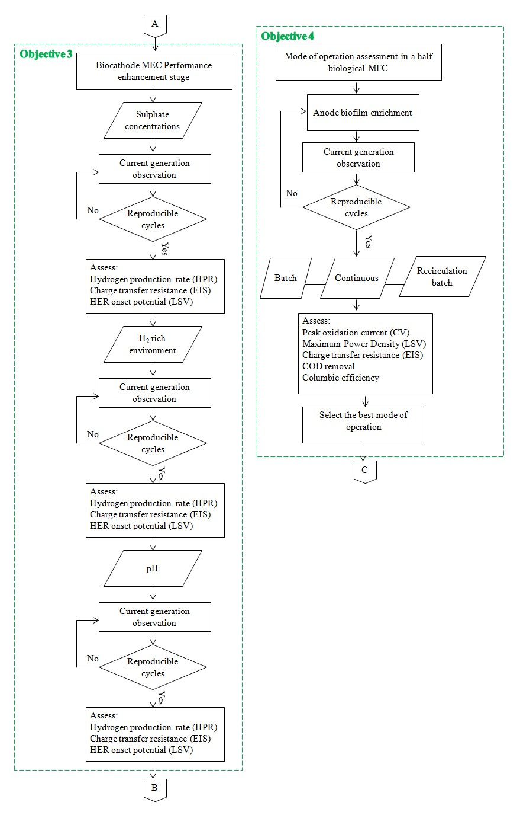
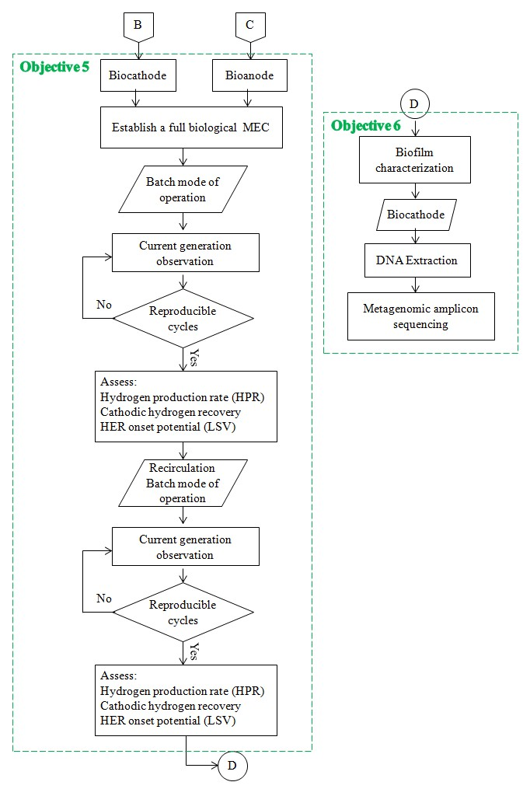
Methodology

Slide 7
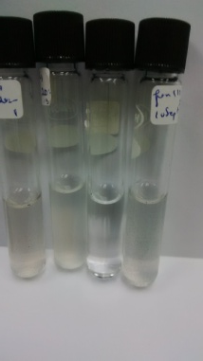
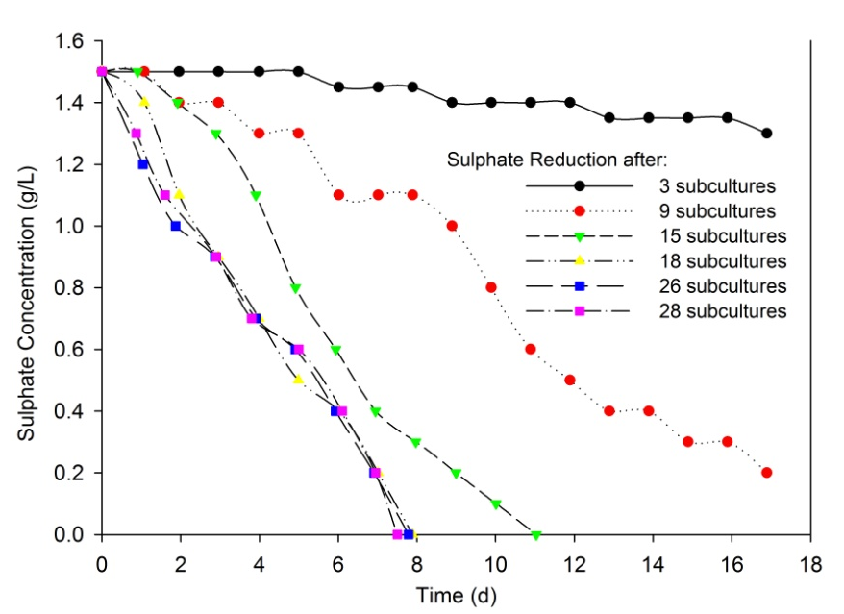
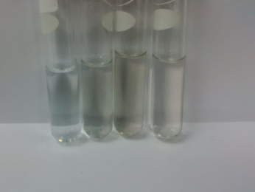
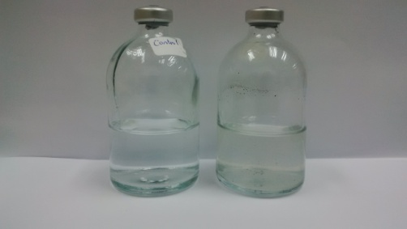
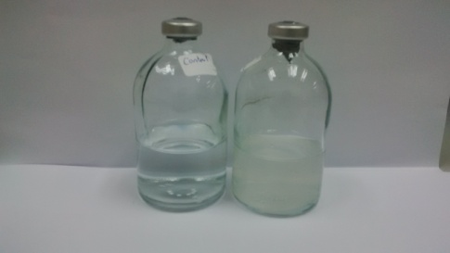
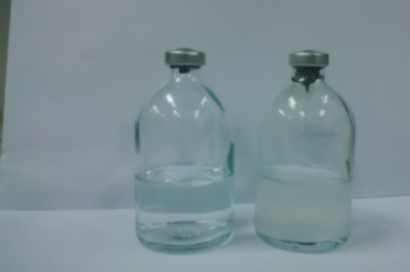
A comprehensive study on development of a biocathode for cleaner production of hydrogen in a microbial electrolysis cell
MEC Biocathode
Stage 1. Ex-situ SRB Enrichment
Sulphate removal in representative cycle during 28 passages of the ex-situ SRB enrichment

Slide 8
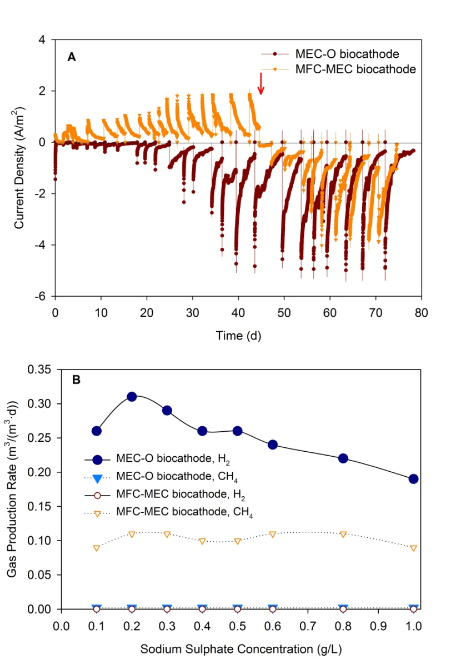
Stage 2. In-situ biocathode development in I)MFC-MEC setup
and
II)MEC-O setup
A) Current density production for two in-situ biocathode development procedures. B) Hydrogen and methane production during the two biocathode development procedures with respect to applying different cathodic media. es.

Slide 9
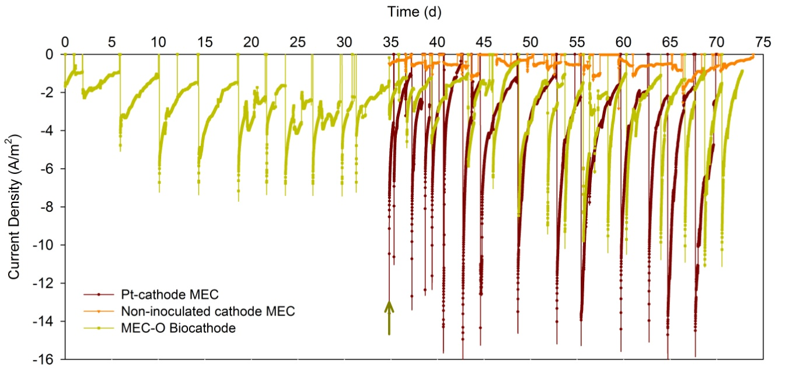
Enhancement MEC-O bioathode enrichment procedure by coupling the system with pt cathode MEC
Current density production in MEC-O biocathode (during the hydrogen supply and after removal of the hydrogen supply), Pt and non-inoculated cathode MECs.
The arrow showed the time that the hydrogen supply to MEC-O bioathode was stopped.

Slide 10
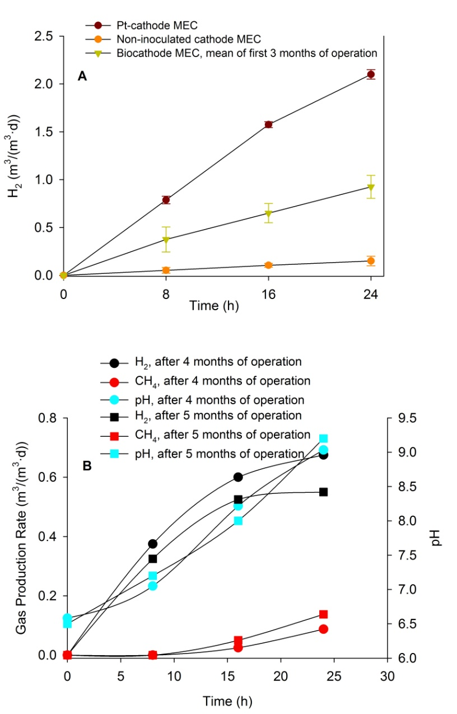
A) Hydrogen production rate over 24-hour hydrogen yield test for biocathode MEC along with control systems of pt and non-inoculated cathode MEC monitored monthly for the third months of operation. B) Hydrogen and Methane production rate over 24-hour gas yield test run after 4 and 5 months of operation along with cathodic pH changes during the runs.

Slide 11
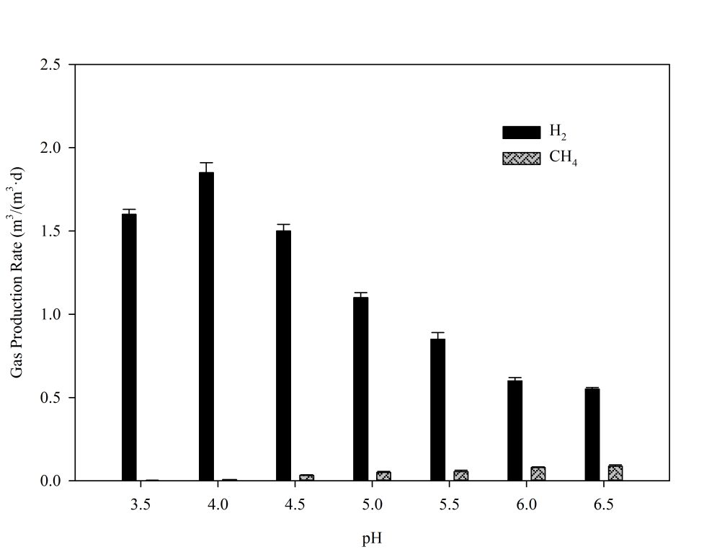
Hydrogen and methane production rate changes with respect to medium pH changes.

Slide 12
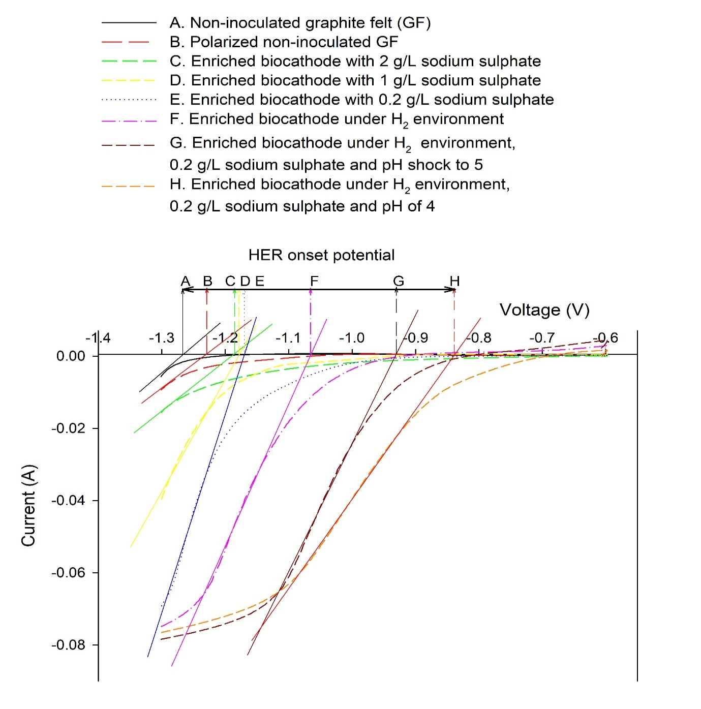
Use of LSV to Asses Hydrogen Evolution Reaction
Demonstration of in-situ LSV plots and cathode HER onset potentials during enrichment stages

Slide 13
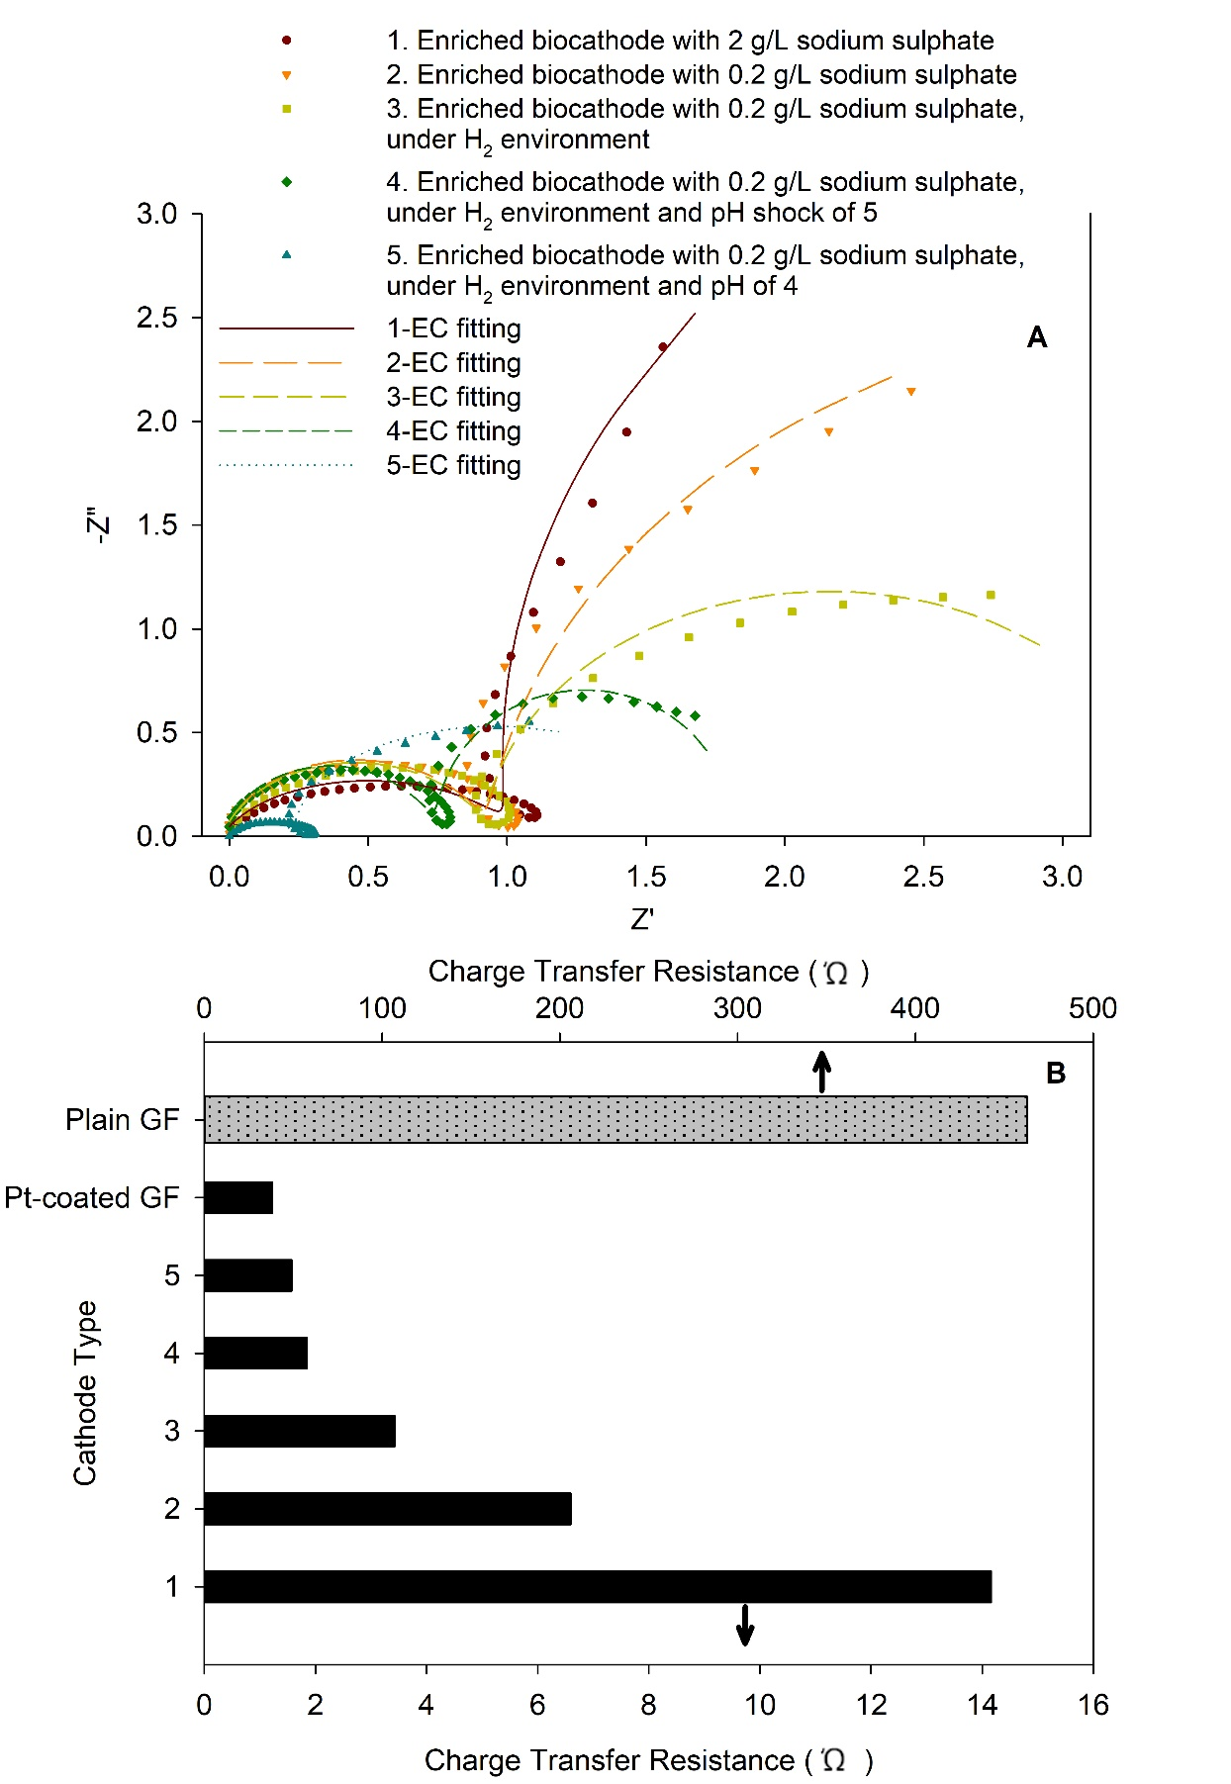
Use of EIS to Asses Hydrogen Evolution Reaction
A) Measured and fitted Nyquist results for the cathodic charge transfer resistance of enriched biocathodes in different stages, B) Simulated values of the cathodic charge transfer resistance for the mentioned biocathode types in section A, plain and Pt-coated cathodes as control systems

Slide 14
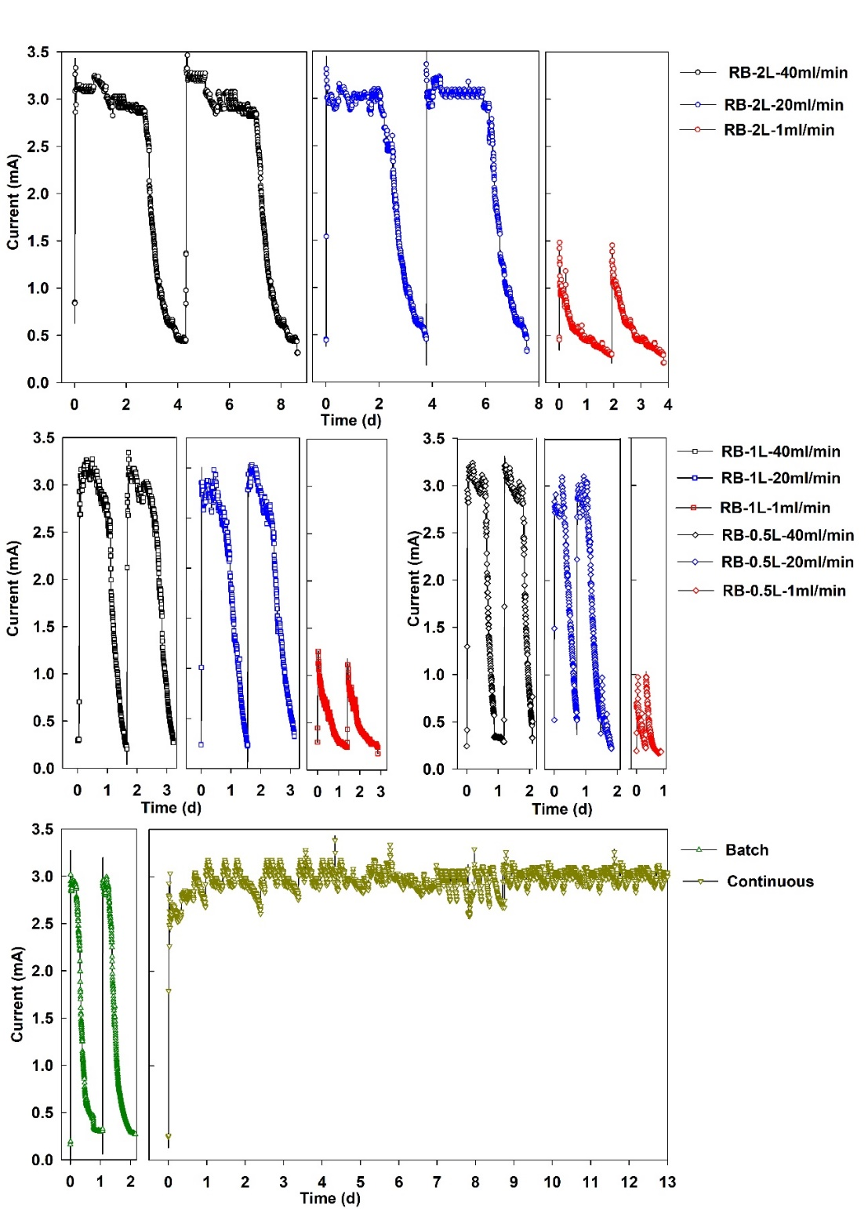
Assessment of modes of operation in bioelectrochemical system
Generation of current in the MFC during the recirculation batch, batch and continuous modes of operation.

Slide 15
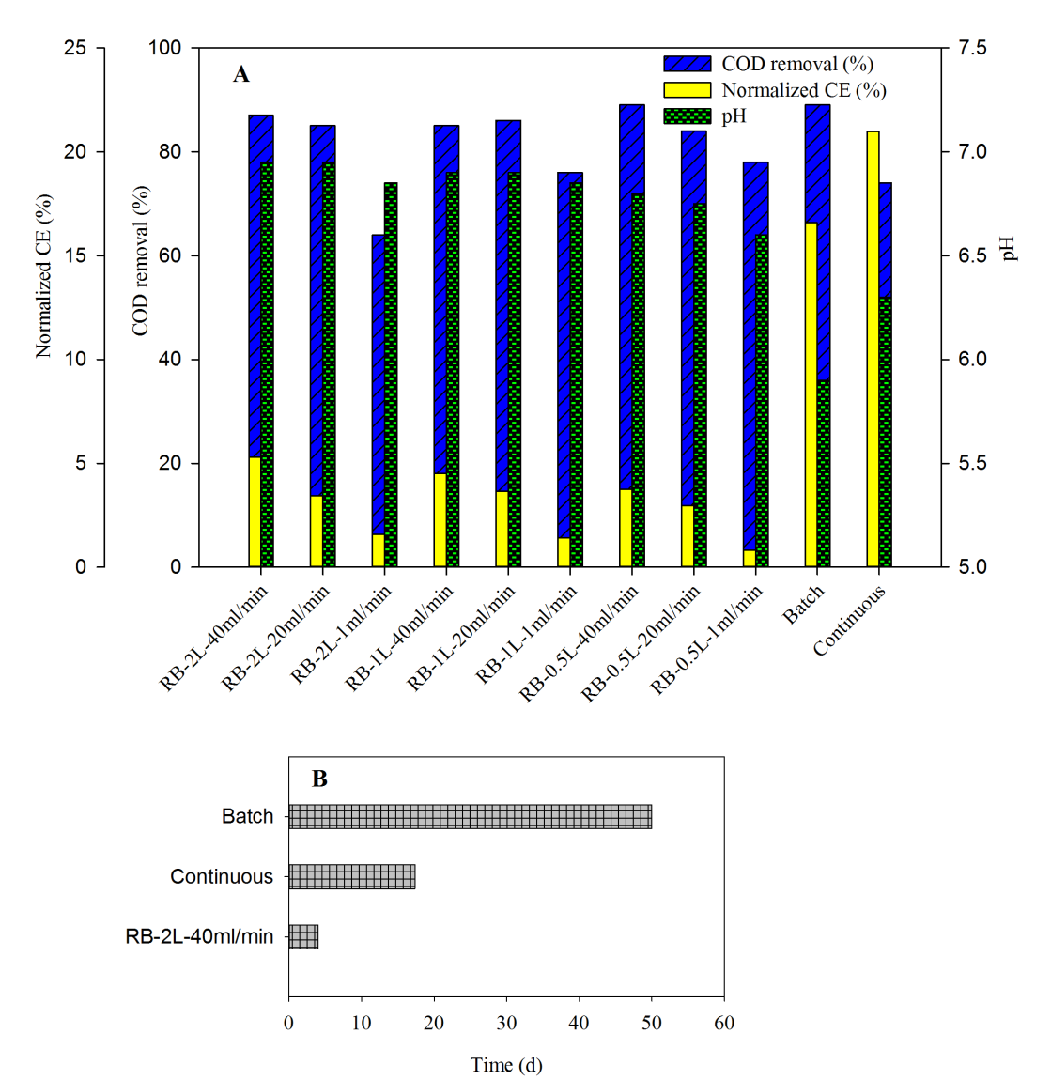
A) PH of the effluent, COD removal and CE of the effluent with respect to the studied modes of operation; B) Duration for treating 2 L of waste in RB-2L-40mL/min, batch and continuous operational modes at their maximum achieved COD removal

Slide 16
Polarization and power density curve for studied modes of operation; A) RB-2L, B) RB-1L, C) RB-0.5L at flow rates of 40, 20 and 1 mL/min and D) batch, and continuous modes

Slide 17
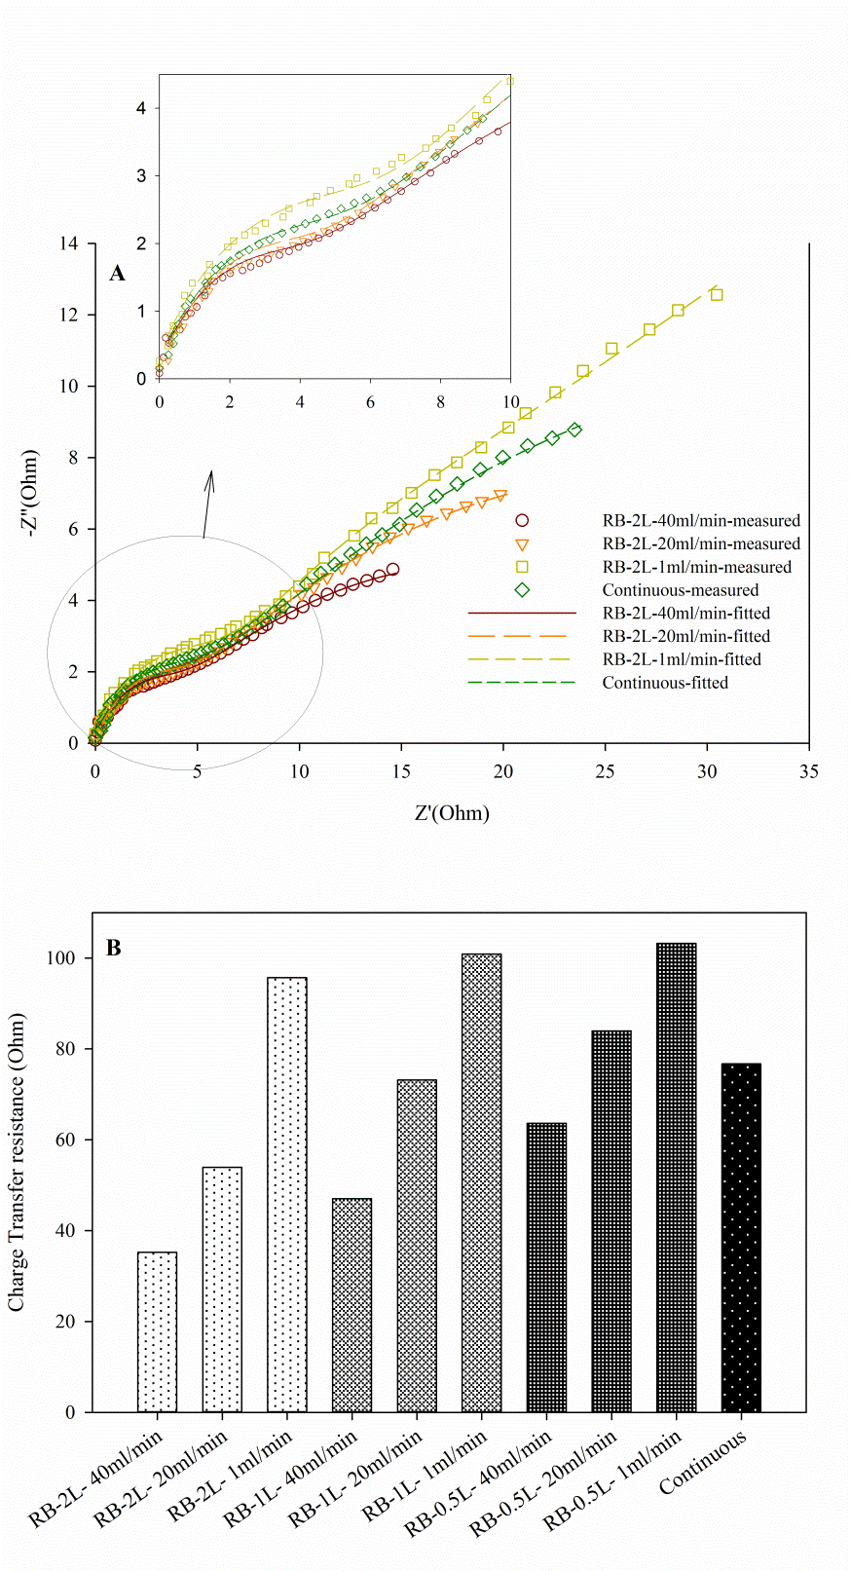
A) Measured and fitted Nyquist results for electron charge transfer resistance of RB-2L system at recirculation rates of 40, 20 and 1 ml/min in continuous mode. B) Simulated values of charge transfer resistance for RB-2L-40, 20, and 1 ml/min and continuous modes of operation.

Slide 18
Summary of power density, CV peak oxidation current, charge transfer resistance and time for 2L of waste treatment versus the studied modes of operation
Mode of Operation | Maximum Power Density (W/m2) | Peak Oxidation Current (mA) | Charge Transfer Resistance (Ώ) | Time Duration for Treating 2L of waste (d)
RB-2L-40mL | 0.95 | 5.8 | 35.23 | 4*
RB-2L-20mL | 0.7 | 4.1 | 53.96 | -
RB-2L-1mL | 0.62 | 2.06 | 95.68 | -
RB-1L-40mL | 0.65 | 4.64 | 47.04 | -
RB-1L-20mL | 0.56 | 2.34 | 73.15 | -
RB-1L-1mL | 0.53 | 1.9 | 100.88 | -
RB-0.5Ll-40mL | 0.58 | 4.78 | 63.63 | -
RB-0.5L-20mL | 0.57 | 3.20 | 83.97 | -
RB-0.5L-1 ml | 0.57 | 1.53 | 103.24 | -
Batch | 0.57 | 1.6 | _ | 50
Continuous | 0.72 | 2.7 | 76.69 | 17

Slide 19
Clean Hydrogen Production in a Full Biological Microbial Electrolysis Cell

Slide 20
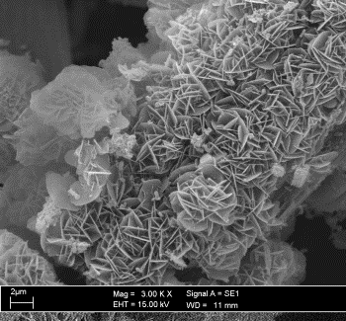
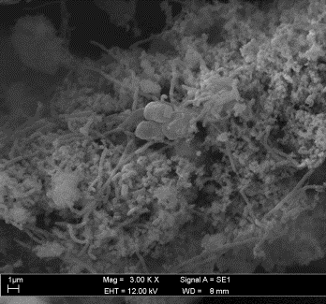
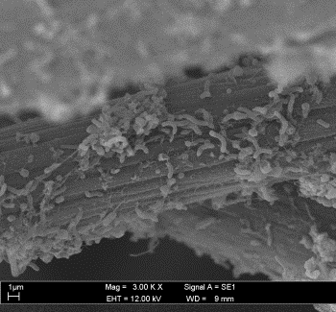
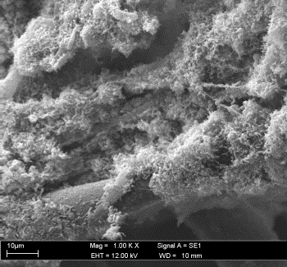
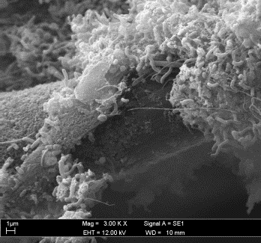
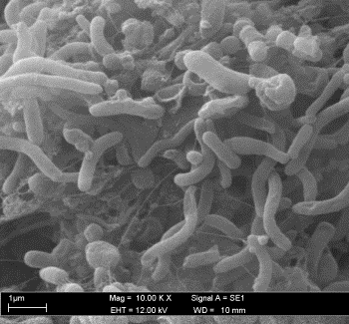
SEM images of the developed MEC Biocathodes under different conditions of SS concentrations and H2 environment; A) 1 g/l SS, W/O H2, B) 1 g/l SS, W/ H2, C) 0.1 g/l SS, W/O H2, D, E and F) 0.1 g/l SS, W/ H2 during the enrichment stage (in different magnifications).

Slide 21
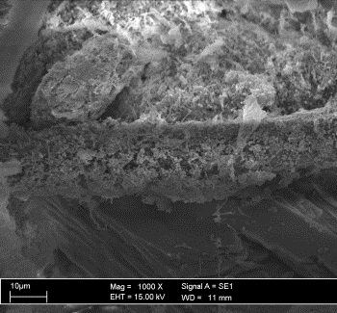
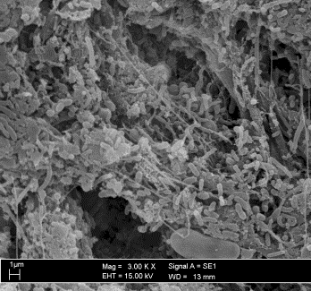
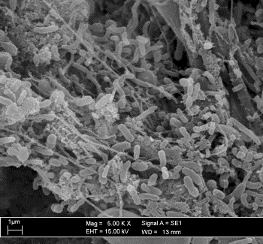
SEM images of the anodic biofilm in different magnifications

Slide 22
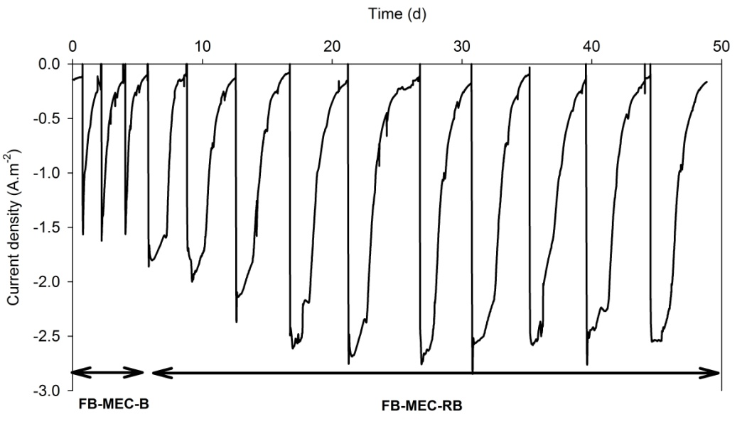
Current density production in the FB-MEC-B and the FB-MEC-RB over the time of operation.

Slide 23
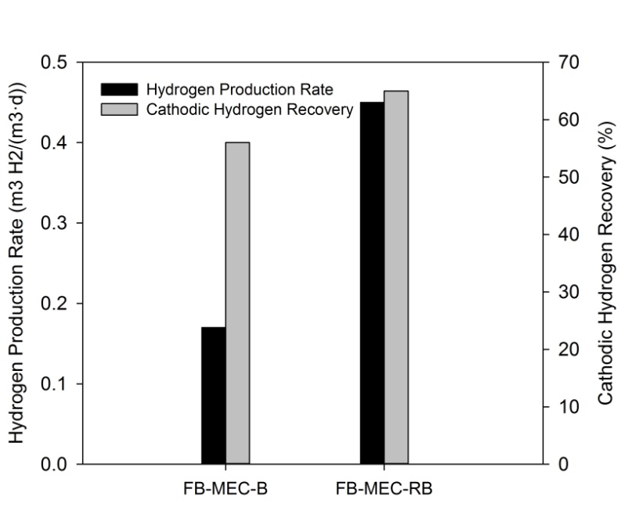
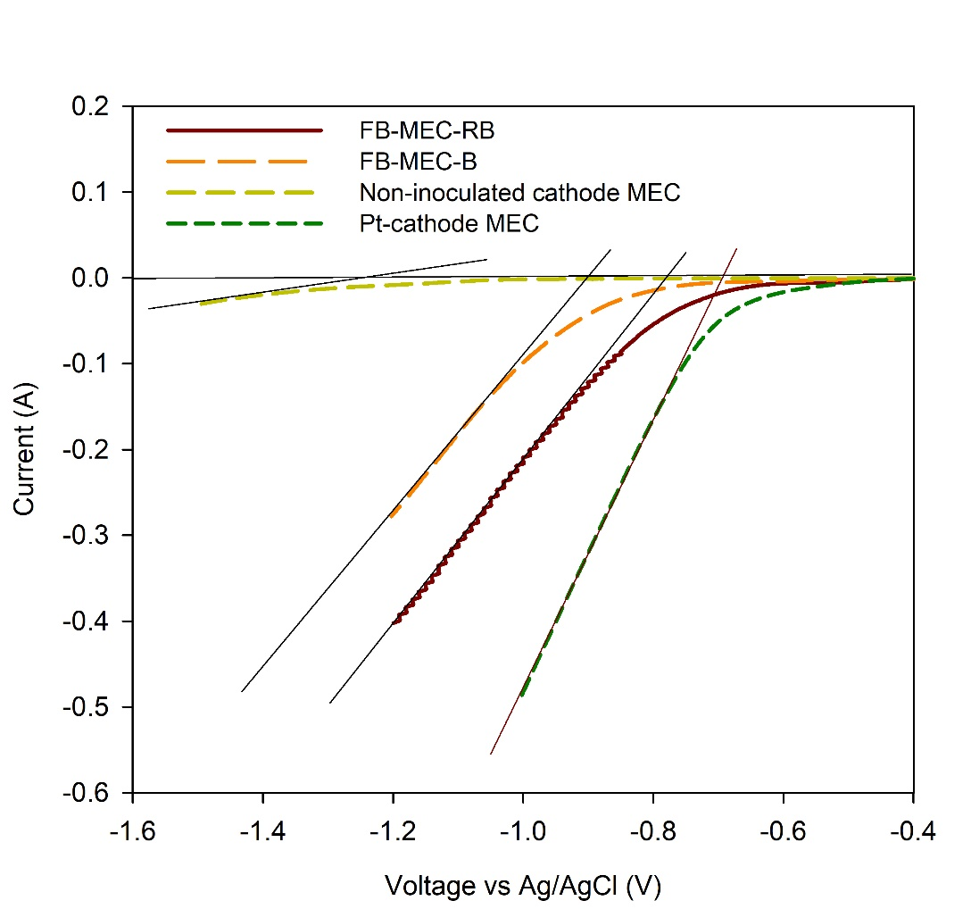
Hydrogen production rate and cathodic hydrogen recovery obtained by the FB-MEC-B and the FB-MEC-RB
In-situ LSV plots and cathode HER onset potentials for the FB-MEC-B, the FB-MEC-RB and Pt and non-inoculated cathode control MECs

Slide 24
MEC | Biocathode type | Biocathode source | Cathodic chamber volume (mL) | Hydrogen production rate | Ref
 | Graphite rod | Pure culture of Desulfovibrio paquessi | 270 | 0.12 | (Aulenta et al. 2012)
 | Graphite granules | Brewery wastewater | 150 | 0.295 | (Marshall et al. 2012)
 | Carbon paper | Previously enriched in anaerobic reactors | 270 | 0.01 | (Villano et al. 2011)
 | Carbon cloth | Previously enriched in an MFC | 250 | 0.46 | (Fu et al. 2013)
 | Carbon cloth | Alkali pre-treated waste sludge | 40 | 0.148 | (Liu et al. 2016)
 | Graphite felt | Using POME as a mixed culture source enriched through comprehensively described ex-situ and in-situ enrichment procedures | 40 | 1.85 | This study
Fermentation | Reactor type | Substrate / seed sources | Reactor volume (L) | Hydrogen production rate (m3H2/m3/d) | Ref
 | UASB-CSTR | POME / sludge | 5 | 2.15 | (Krishnan et al. 2016)
 | UASB–CSTR | POME / sludge | 4 | 1.72 | (Krishnan et al. 2016)
 | Batch serum bottle | POME / sludge | 0.5 | 1.24 | (Mohammadi et al. 2012)
 | Batch serum bottle | POME / decanter cake | 0.5 | 1.48 | (Suksong et al. 2015)

Slide 25
Contribution and Conclusions
An autotrophic MEC biocathode was successfully developed for the purpose of hydrogen production in a half biological setup through the ex-situ and in-situ enrichment stages. SRB-rich culture was enriched from POME during the ex-situ enrichemnt stage and the hydrogen producing biocathode was enriched through the in-situ enrichment stage.
An MEC-O biocathode showed more promise results with regard to the rate of hydrogen production (0.18 m3 H2/(m3.d)) compared to the MFC-MEC biocathode system, which mainly produced methane.
An acidic (pH=4), low sulphate content medium (0.2 g/L), which was enriched under a H2 environment, accelerated the biocathode formation and increased the rate of production of hydrogen gas (1.85 m3 H2/(m3.d)).Methane was completely hindered by utilizing an acidic medium within the MEC biocathode chamber.
The LSV analysis showed that the HER potential decreased by 430 mV, while the hydrogen production was increased by 6 times compared to the non-inoculated graphite felt cathode, saving about 1 KWh/m3 of the required applied energy for the HER reaction.
The EIS tests showed that the cathodic charge transfer resistance value of the optimized enriched biocathode MEC (1.56 Ώ) was comparable to that of the Pt-cathode MEC (1.22 Ώ).

Slide 26
The system running in an easy-maintained and controlled recirculation batch mode of operation achieved a high COD removal rate with a fast and long oxidation response while producing high clean energy of 0.95 W/m2 compared to 0.72 and 0.57 W/m2 obtained in the continuous and batch systems.
The time taken for the treatment of the equal volume of the waste in the BES running under RB operation mode was decreased significantly by more than 4 and 12 times compared to the continuous and batch systems, respectively.
The pH of the effluent in the BES running under RB operation mode remained close to the required releasing point, removing the need for further adjustments by extra chemicals, improving the cleaner production of energy while treating the waste, cutting time and cost.
The highest oxidation rate and the lowest charge transfer resistance were recorded by the CV and EIS analyses for the studied recirculation batch system (5.8 mA and 35 Ώ) compared to the continuous (2.7 mA and 77 Ώ) and batch (1.6 mA) systems.

Slide 27
The full biological MEC was successfully established by using the enriched bioanode and the biocathode from the half biological MFC and MEC systems.
The FB-MEC could compete with the HB-MEC in terms of cathodic hydrogen recovery and HER onset potential. The FB-MEC system under recirculation batch mode of operation demonstrated the higher cathodic hydrogen recovery and hydrogen production rate compared to the FB-MEC under the batch mode of operation (65% and 0.45 m3 H2/(m3.d) against 56% and 0.17 m3 H2/(m3.d)). The high HER onset potential of the abiotic control system was significantly reduced by 500 mV when the oxidation and reduction reaction were biologically catalyzed by the biofilm attached to the electrodes in FB-MECs.
The high dominancy of Proteobacteria in phylum and Desulfovribio in genus level supported the energy conservation mechanism suggested for HER in MEC biocathodes by Desulfovribio.

Slide 28
Publications:
Journal publications
Jafary, T., Daud, W. R. W., Ghasemi, M., Bakar, M. H. A., Aljlil, S.A., Kim, B. H., Carmona-Martínez, A.A., Jahim, J. M., Ismail, M. Clean Hydrogen Production in a Full Biological Microbial Electrolysis Cell. Accepted in International Journal of Hydrogen Energy. (Q2, IF=3.582)
Jafary, T., Daud, W.R.W., Ghasemi, M., Kim, B.H., Carmona-Martínez, A.A., Bakar, M.H.A., Jahim, J.M., Ismail, M. 2017. A comprehensive study on development of a biocathode for cleaner production of hydrogen in a microbial electrolysis cell. Journal of Cleaner Production 164: 1135-1144. (Q1, IF=5.715)
Jafary, T., Daud, W. R. W., Ghasemi, M., Kim, B. H., Bakar, M. H. A., Jahim, J. M., Ismail, M., Kamaruzzaman, M. A. 2017. Assessment of recirculation batch mode of operation in bioelectrochemical system; a way forward for cleaner production of energy and waste treatment. Journal of Cleaner Production 142: 2544-2555. (Q1, IF=5.715)
Jafary, T., Daud, W. R. W., Ghasemi, M., Kim, B. H., Jahim, J. M., Ismail, M., & Lim, S. S. 2015. Biocathode in microbial electrolysis cell; present status and future prospects. Renewable and Sustainable Energy Reviews 47: 23-33. (Q1, IF=8.050)
Jafary, T., Aljlil, S.A., Alam, J., Ghasemi, M. 2017. Effect of the membrane type and resistance load on the performance of the microbial fuel cell; A step ahead of microbial desalination cell establishment. Journal of the Japan Institute of Energy 96: 346-351. (Scopus Indexed)
Ghasemi, M., Ahmad, A., Jafary, T., Azad, A. K., Kakooei, S., Daud, W. R. W., & Sedighi, M. 2017. Assessment of immobilized cell reactor and microbial fuel cell for simultaneous cheese whey treatment and lactic acid/electricity production. International Journal of Hydrogen Energy 42(14): 9107-9115. (Q2, IF=3.582)
Ghasemi, M., Daud W.R.W., Hassan S.H., Jafary T., Rahimnejad M., Ahmad A., Yazdi M.H. 2016. Carbon nanotube/polypyrrole nanocomposite as a novel cathode catalyst and proper alternative for Pt in microbial fuel cell. International Journal of Hydrogen Energy 41(8): 4872-4878. (Q2, IF=3.582)
Jafary, T., Rahimnejad, M., Ghoreyshi, A. A., Najafpour, G., Hghparast, F., Daud, W. R. W. 2013. Assessment of bioelectricity production in microbial fuel cells through series and parallel connections”. Energy Conversion and Management 75: 256-262. (Q1, IF=5.589)
Conference publications
Jafary, T., Daud, W. R. W., Ghasemi, M., Bakar, M. H. A., Jahim, J. M., Kim, B. H., Ismail, M. 2017. Sustainable and Enhanced Biocathode Startup by an Abio-Bio Cathode Configuration for Hydrogen Production in a Microbial Electrolysis Cell, 6th International Conference on Fuel Cell & Hydrogen Technology (ICFCHT), April 11-13, Putrajaya, Malaysia.
Jafary, T., Daud, W. R. W., Ghasemi, M., Kim, B. H., Jahim, J. M., Ismail, M. 2016. Assessment of Mode of Operation for Integrated Bioelectrochemical Systems; Power, bioelectrochemical and waste treatment evaluation, 29th Symposium of Malaysian Chemical Engineers (SOMChE), December 1 – 3, Miri, Sarawak, Malaysia.
Jafary T., Ghasemi, M., Daud, W. R. W., Jahim, J. M. 2014. Polypyrrole and Carbon nanotube/Polypyrrole nanocomposite as a novel cathode catalysts and proper alternatives for Pt in microbial fuel cell, Asia Biohydrogen and Biorefinery Symposium (ABB), December 16-18, Melaka, Malaysia.
Jafary, T., Daud, W. R. W., Ghasemi, M., Kim, B. H., Jahim, J. M., Ismail, M., A. 2015. Review on Biohydrogen Production in Biocathode Microbial Electrolysis Cell, 28th Symposium of Malaysian Chemical Engineers (SOMChE), October 21-22, Putrajaya, Malaysia.

Slide 29



Thank You

